Slide 1
DEMO 3
Team Members : Thomas Farquharson, Bhavan Pahuja, Julian Masznicz

Slide 2
Objective of The Game:
Ludo is a strategy board game for two to four players, in which the players race their four tokens from start to finish according to the rolls of a single die. Like other cross and circle games, Ludo is derived from the Indian game Pachisi, but simpler. The game and its variations are popular in many countries and under various names.

Slide 3
Things Added:
We finally have a working GUI version. Yay!!
We have added JUnit tests for basic getter and setter methods for our Token, User and Dice classes.
We also now have 2 die instead of one to increase the game complexity.

Slide 4
Initial Prompt :
The first prompt is for the user to select the number of players in the game.
According to the input by the user, the board is created.

Slide 5
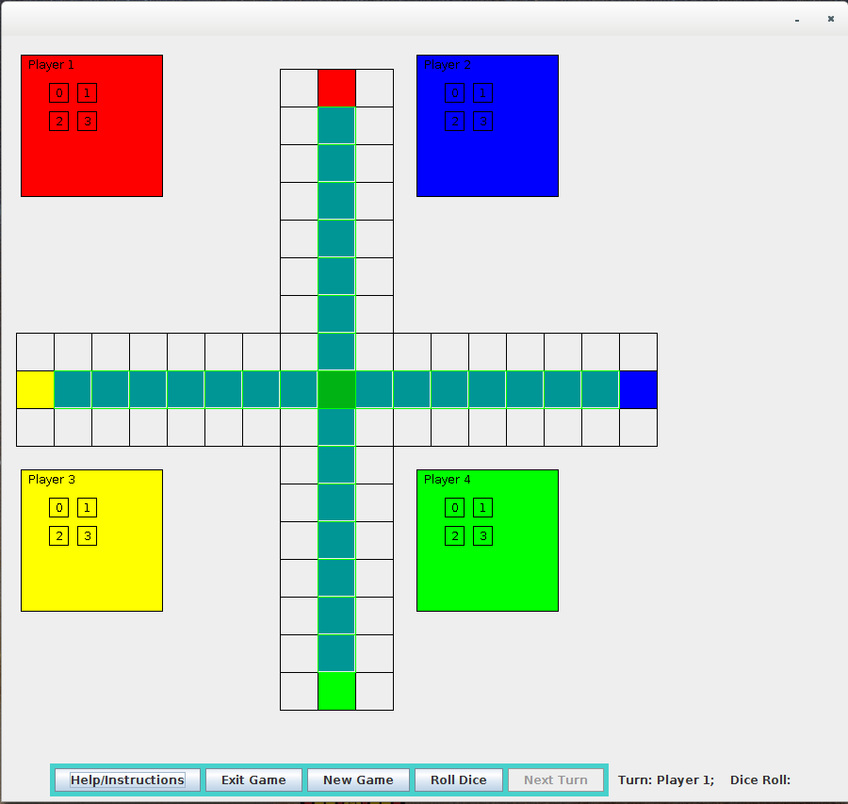
The Game:
Special areas of the Ludo board are typically coloured bright yellow, green, red, and blue. Each player is assigned a colour and has four tokens in their colour. The board is normally square with a cross-shaped playspace, with each arm of the cross having three columns of squares, usually six per column. The middle columns usually have five squares coloured; these represent a player's home column. A sixth coloured square not on the home column is a player's starting square. At the centre of the board is a large finishing square, often composed of coloured triangles atop the players' home columns (thus depicting "arrows" pointing to the finish).

Slide 6
The Issues:
Players can’t knock each other’s token out in the GUI version.
Not so great looking GUI.
Rolling the dice with just the enter key instead of having to click the button.
Adding AI to the game.

